Slide 1
Your Masters Dissertation
Dr Mohamad Janaby
University of Glasgow
2025/2026

Slide 2
Welcome to the LLM Dissertation Info Session
9:00–9:20 – Ordinary Dissertations (MJ)
9:20–9:35 – Collaborative Dissertations (JS)
9:35 - 09:55 Q&A
9:55–10:00 – Break
10:00–10:40 – General Advice on Writing LLM Dissertations (Neil)
10:40–11:00 – Q&A

Slide 3
Important information
The key information is available on the dedicated Moodle page. See in particular the Dissertation Guidelines
It is a compulsory course
The dissertation accounts for 60 credits in the LLM programmes.
You work independently on a topic of your choice, producing a major piece of research!
You need to write a 12000-word dissertation

Slide 4
Contacts
The administration team at: law-dissertation-pgt-enquiries@glasgow.ac.uk
The Dissertation Coordinators are
Dr Mohamad Janaby (mohamad.janaby@glasgow.ac.uk) (Semester 1)
Dr Gavin Faulkner (Gavin.Faulkner@glasgow.ac.uk)
Your supervisor.

Slide 5
The timeline
January:
- Choose topic.
- Attend LLM Dissertation meeting with your Programme Convenor.
- Q & A sessions available with Dissertation Convenors.
- You will receive messages about the dates.
1
By 2 February 2026, submit your Dissertation Topic on Moodle.
2
Towards the end of term 2, you will receive the details of the allocated supervisor.
3
In May: produce a dissertation proposal and arrange your first supervision meeting.
4
Before the End of June: Submit draft chapter to your supervisor and arrange a second meeting.
5
13 August 2026: Submission of dissertation

Slide 6
Choice of topic
General Requirements
Choose something you are interested in
In any area of law, provided a qualified supervisor is available.
To qualify for a titular LLM, the topic must fall within that LLM’s subject area.
The topic need not be taught in your programme and may include interdisciplinary aspects (e.g. politics, economics, history).
Remember: this is a law dissertation and will be assessed accordingly.
Selecting a Suitable Topic
Choose a precise, focused topic that allows for original legal analysis.
Avoid topics that are too broad (risk of descriptive writing) or too narrow (insufficient depth).
Students must conduct independent research to select their own topic—staff will not assign topics.
Programme Conveners will hold a topic guidance session before the submission deadline.
Submission of Two Titles
You must submit two dissertation titles by Tuesday, 3 February 2026, via Moodle.
Each title must come from a different sub-field or pathway (e.g. International Law and Commercial Law).
Level of Specificity
Topics must be clearly defined and researchable.
Example (focused): The legality of targeted killings using unmanned drones under international law.
Example (too broad): Terrorism in the 21st Century.
Topics involving foreign law must include comparative or international analysis, not focus solely on one jurisdiction.
No substantial overlap between class essays and the dissertation.
General LLM
Commercial Law Pathway:
Corporate and Financial Law
International Commercial Law
International Competition Law & Policy
Intellectual Property Pathway:
Intellectual Property and the Digital Economy
International Competition Law and Policy
Technology Law & Regulation
International Law Pathway:
International Economic Law
International Law
International Law & International Security
Human Rights Law

Slide 7
Dissertation Supervision & Responsibilities
Key Objectives
Produce a substantial piece of independent research with critical analysis.
Final submission must be entirely the student’s own work.
Students are responsible for planning and completing all tasks; supervisors provide guidance only.
Supervision Responsibilities
Supervisors do not actively monitor progress.
Students must arrange meetings and contact points themselves.
Missing timelines may prevent feedback in time for revisions.
International Students (on Student Visa)
Must follow the supervision schedule strictly for UKVI compliance.
In-person attendance at the July workshop is mandatory.
Supervisory meetings in May and June must take place (in-person or virtual)
First Meeting (May)
Discuss dissertation proposal.
Submit a 5-page proposal at least 3 days in advance.
Can be in-person or virtual (Zoom, Teams).
Second Contact Point (June)
Review a draft section (max 1 chapter / 3,000 words).
Feedback provided via meeting (in-person/virtual) for international students; email feedback possible for others.
Limits on Supervision
Only two formal meetings per dissertation.
Regular emails or requests for advice are not permitted unless for exceptional circumstances (e.g., access issues, extension requests).

Slide 8

Plagiarism and Self-Plagiarism
Plagiarism
Check Policy carefully
URKUND/Turnitin
No overlap with class essays
Be careful with AI-generated content! This can lead to student misconduct proceedings!
=> The dissertation must be your own work!

Slide 9
Form of the dissertation
12,000 words, penalties for excess apply!
Check guidance on presentation carefully.
Footnotes and appendices (but not bibliography, title page, table of cases, table of abbreviations, dedications page or contents page) count in assessing the number of words.
OSCOLA: here

Slide 10

Some useful books:
B Garner, The Elements of Legal Style (2nd edn 2002) here
B Garner, A Dictionary of Modern English Usage (2nd edn 1995) here
Black’s Law Dictionary (10th edn 2014) here
W W McBryde, “The Citation of Cases in Court” in H L MacQueen (ed) Scots law into the 21st century: essays in honour of W.A. Wilson (1996) 170-181 here

Slide 11

Some useful Moodle resources:
https://moodle.gla.ac.uk/course/index.php?categoryid=2607
International Student Study and Writing Community
https://moodle.gla.ac.uk/course/index.php?categoryid=90
Advanced Criticality Classes
https://moodle.gla.ac.uk/course/view.php?id=10313
PGT Dissertation Development and Writing Classes
https://www.gla.ac.uk/myglasgow/sld/about/team/college/socialsciences/
General advice

Slide 12
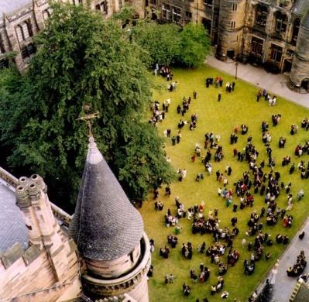
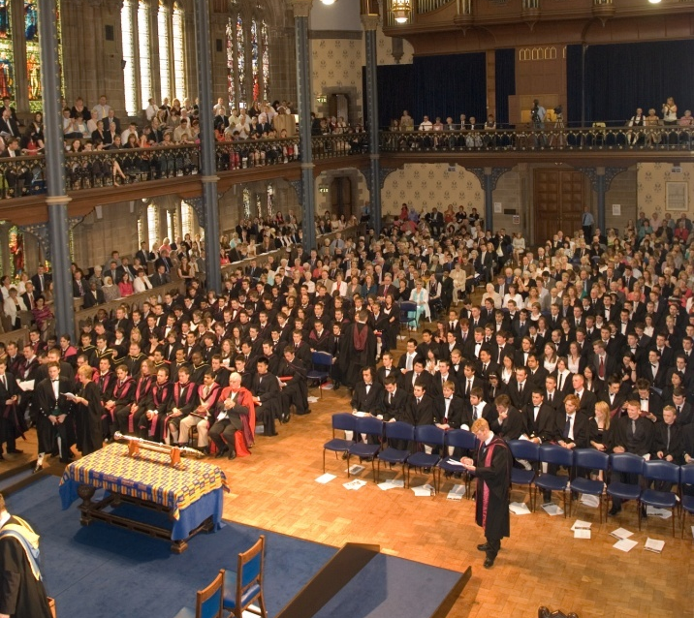
And finally…
Pick something you are interested in, and you will enjoy researching it.
You are more likely to do well then!
The best dissertation(s) will receive awards.
All the best!

